Slide 1

Chapter Seven
Constraint Satisfaction Problem.

Slide 2
Learning objectives.
7.1 Constraint satisfaction problem
7.1.1 Example Map Coloring
7.2 Solving Constraint satisfaction problem
7.2.1 Backtracking
7.2.2 Forward Checking
7.2.3 Ordering
7.3 Queens Problem
7.4 Cryptoarithmetic Problem
After this chapter , students will be able to :
Understand the different types of constraints and can be expressed in formal manner.
Learn how the constraint satisfaction problems can be modelled as search problems.
Cast the different types of constraint satisfaction problems as search develop a general appreciation of the goals, subareas, achievements and difficulties of artificial intelligence.

Slide 3
Constraint satisfaction problem
7.1 Constraint satisfaction problem
7.1.1 Example Map Coloring
7.2 Solving Constraint satisfaction problem
7.2.1 Backtracking
7.2.2 Forward Checking
7.2.3 Ordering
7.3 Queens Problem
7.4 Cryptoarithmetic Problem
Standard search problem:
state is a "black box“ – any data structure that supports successor function, heuristic function, and goal test.
CSP:
state is defined by variables X_{i} with values from domain D_{i}
goal test is a set of constraints specifying allowable combinations of values for subsets of variables
Simple example of a formal representation language
Allows useful general-purpose algorithms with more power than standard search algorithms

Slide 4
Intro Example: 8-Queens
7.1 Constraint satisfaction problem
7.1.1 Example Map Coloring
7.2 Solving Constraint satisfaction problem
7.2.1 Backtracking
7.2.2 Forward Checking
7.2.3 Ordering
7.3 Queens Problem
7.4 Cryptoarithmetic Problem
Purely generate-and-test
The “search” tree is only used to enumerate all possible 64⁸ combinations

Slide 5
Intro Example: 8-Queens
7.1 Constraint satisfaction problem
7.1.1 Example Map Coloring
7.2 Solving Constraint satisfaction problem
7.2.1 Backtracking
7.2.2 Forward Checking
7.2.3 Ordering
7.3 Queens Problem
7.4 Cryptoarithmetic Problem
Another form of generate-and-test, with no
redundancies → “only” 8⁸ combinations

Slide 6
Intro Example: 8-Queens
7.1 Constraint satisfaction problem
7.1.1 Example Map Coloring
7.2 Solving Constraint satisfaction problem
7.2.1 Backtracking
7.2.2 Forward Checking
7.2.3 Ordering
7.3 Queens Problem
7.4 Cryptoarithmetic Problem

Slide 7
What is Needed?
7.1 Constraint satisfaction problem
7.1.1 Example Map Coloring
7.2 Solving Constraint satisfaction problem
7.2.1 Backtracking
7.2.2 Forward Checking
7.2.3 Ordering
7.3 Queens Problem
7.4 Cryptoarithmetic Problem
Not just a successor function and goal test
But also a means to propagate the constraints imposed by one queen on the others and an early failure test
→ Explicit representation of constraints and constraint manipulation algorithms.

Slide 8
Constraint Satisfaction Problem
7.1 Constraint satisfaction problem
7.1.1 Example Map Coloring
7.2 Solving Constraint satisfaction problem
7.2.1 Backtracking
7.2.2 Forward Checking
7.2.3 Ordering
7.3 Queens Problem
7.4 Cryptoarithmetic Problem
Set of variables {X1, X2, …, Xn}
Each variable Xi has a domain Di of possible values
Usually Di is discrete and finite
Set of constraints {C1, C2, …, Cp}
Each constraint Ck involves a subset of variables and specifies the allowable combinations of values of these variables

Slide 9
Constraint Satisfaction Problem
7.1 Constraint satisfaction problem
7.1.1 Example Map Coloring
7.2 Solving Constraint satisfaction problem
7.2.1 Backtracking
7.2.2 Forward Checking
7.2.3 Ordering
7.3 Queens Problem
7.4 Cryptoarithmetic Problem
Set of variables {X1, X2, …, Xn}
Each variable Xi has a domain Di of possible values
Usually Di is discrete and finite
Set of constraints {C1, C2, …, Cp}
Each constraint Ck involves a subset of variables and specifies the allowable combinations of values of these variables
Assign a value to every variable such that all constraints are satisfied

Slide 10
Example: 8-Queens Problem
7.1 Constraint satisfaction problem
7.1.1 Example Map Coloring
7.2 Solving Constraint satisfaction problem
7.2.1 Backtracking
7.2.2 Forward Checking
7.2.3 Ordering
7.3 Queens Problem
7.4 Cryptoarithmetic Problem
64 variables Xij, i = 1 to 8, j = 1 to 8
Domain for each variable {yes,no}
Constraints are of the forms:
Xij = yes ➔ Xik = no for all k = 1 to 8, k≠j
Xij = yes ➔ Xkj = no for all k = 1 to 8, k≠I
Similar constraints for diagonals

Slide 11
Example: 8-Queens Problem
7.1 Constraint satisfaction problem
7.1.1 Example Map Coloring
7.2 Solving Constraint satisfaction problem
7.2.1 Backtracking
7.2.2 Forward Checking
7.2.3 Ordering
7.3 Queens Problem
7.4 Cryptoarithmetic Problem
8 variables Xi, i = 1 to 8
Domain for each variable {1,2,…,8}
Constraints are of the forms:
Xi = k ➔ Xj ≠ k for all j = 1 to 8, j≠i
Similar constraints for diagonals

Slide 12
Example: Map Coloring
7.1 Constraint satisfaction problem
7.1.1 Example Map Coloring
7.2 Solving Constraint satisfaction problem
7.2.1 Backtracking
7.2.2 Forward Checking
7.2.3 Ordering
7.3 Queens Problem
7.4 Cryptoarithmetic Problem
NT
NT
Q
Q
WA
WA
SA
SA
NSW
NSW
V
V
T
T
7 variables {WA,NT,SA,Q,NSW,V,T}
Each variable has the same domain {red, green, blue}
No two adjacent variables have the same value:
WA≠NT, WA≠SA, NT≠SA, NT≠Q, SA≠Q, SA≠NSW, SA≠V,Q≠NSW, NSW≠V

Slide 13
Example: Street Puzzle
7.1 Constraint satisfaction problem
7.1.1 Example Map Coloring
7.2 Solving Constraint satisfaction problem
7.2.1 Backtracking
7.2.2 Forward Checking
7.2.3 Ordering
7.3 Queens Problem
7.4 Cryptoarithmetic Problem
1
2
3
4
5
Ni = {English, Spaniard, Japanese, Italian, Norwegian}
Ci = {Red, Green, White, Yellow, Blue}
Di = {Tea, Coffee, Milk, Fruit-juice, Water}
Ji = {Painter, Sculptor, Diplomat, Violonist, Doctor}
Ai = {Dog, Snails, Fox, Horse, Zebra}

Slide 14
Example: Street Puzzle
7.1 Constraint satisfaction problem
7.1.1 Example Map Coloring
7.2 Solving Constraint satisfaction problem
7.2.1 Backtracking
7.2.2 Forward Checking
7.2.3 Ordering
7.3 Queens Problem
7.4 Cryptoarithmetic Problem
The Englishman lives in the Red house
The Spaniard has a Dog
The Japanese is a Painter
The Italian drinks Tea
The Norwegian lives in the first house on the left
The owner of the Green house drinks Coffee
The Green house is on the right of the White house
The Sculptor breeds Snails
The Diplomat lives in the Yellow house
The owner of the middle house drinks Milk
The Norwegian lives next door to the Blue house
The Violonist drinks Fruit juice
The Fox is in the house next to the Doctor’s
The Horse is next to the Diplomat’s
1
2
3
4
5
Ni = {English, Spaniard, Japanese, Italian, Norwegian}
Ci = {Red, Green, White, Yellow, Blue}
Di = {Tea, Coffee, Milk, Fruit-juice, Water}
Ji = {Painter, Sculptor, Diplomat, Violonist, Doctor}
Ai = {Dog, Snails, Fox, Horse, Zebra}
Who owns the Zebra?
Who drinks Water?

Slide 15
Example: Task Scheduling
7.1 Constraint satisfaction problem
7.1.1 Example Map Coloring
7.2 Solving Constraint satisfaction problem
7.2.1 Backtracking
7.2.2 Forward Checking
7.2.3 Ordering
7.3 Queens Problem
7.4 Cryptoarithmetic Problem
T1
T2
T4
T3
T1 must be done during T3
T2 must be achieved before T1 starts
T2 must overlap with T3
T4 must start after T1 is complete
Are the constraints compatible?
Find the temporal relation between every two tasks

Slide 16
Finite vs. Infinite CSP
7.1 Constraint satisfaction problem
7.1.1 Example Map Coloring
7.2 Solving Constraint satisfaction problem
7.2.1 Backtracking
7.2.2 Forward Checking
7.2.3 Ordering
7.3 Queens Problem
7.4 Cryptoarithmetic Problem
Finite domains of values → finite CSP
Infinite domains → infinite CSP

Slide 17
Finite vs. Infinite CSP
7.1 Constraint satisfaction problem
7.1.1 Example Map Coloring
7.2 Solving Constraint satisfaction problem
7.2.1 Backtracking
7.2.2 Forward Checking
7.2.3 Ordering
7.3 Queens Problem
7.4 Cryptoarithmetic Problem
Finite domains of values → finite CSP
Infinite domains → infinite CSP
We will only consider finite CSP

Slide 18
Constraint Graph
7.1 Constraint satisfaction problem
7.1.1 Example Map Coloring
7.2 Solving Constraint satisfaction problem
7.2.1 Backtracking
7.2.2 Forward Checking
7.2.3 Ordering
7.3 Queens Problem
7.4 Cryptoarithmetic Problem
Binary constraints
T1
T2
T4
T3
NT
Q
WA
SA
NSW
V
T
Two variables are adjacent or neighbors if they
are connected by an edge or an arc

Slide 19
CSP as a Search Problem
7.1 Constraint satisfaction problem
7.1.1 Example Map Coloring
7.2 Solving Constraint satisfaction problem
7.2.1 Backtracking
7.2.2 Forward Checking
7.2.3 Ordering
7.3 Queens Problem
7.4 Cryptoarithmetic Problem
Initial state: empty assignment
Successor function: a value is assigned to any unassigned variable, which does not conflict with the currently assigned variables
Goal test: the assignment is complete
Path cost: irrelevant

Slide 20
CSP as a Search Problem
7.1 Constraint satisfaction problem
7.1.1 Example Map Coloring
7.2 Solving Constraint satisfaction problem
7.2.1 Backtracking
7.2.2 Forward Checking
7.2.3 Ordering
7.3 Queens Problem
7.4 Cryptoarithmetic Problem
Initial state: empty assignment
Successor function: a value is assigned to any unassigned variable, which does not conflict with the currently assigned variables
Goal test: the assignment is complete
Path cost: irrelevant
n variables of domain size d → O(d^{n}) distinct complete assignments

Slide 21
Remark
7.1 Constraint satisfaction problem
7.1.1 Example Map Coloring
7.2 Solving Constraint satisfaction problem
7.2.1 Backtracking
7.2.2 Forward Checking
7.2.3 Ordering
7.3 Queens Problem
7.4 Cryptoarithmetic Problem
Finite CSP include 3SAT as a special case (see class of CS311)
3SAT is known to be NP-complete
So, in the worst-case, we cannot expect to solve a finite CSP in less than exponential time

Slide 22
Commutativity of CSP
7.1 Constraint satisfaction problem
7.1.1 Example Map Coloring
7.2 Solving Constraint satisfaction problem
7.2.1 Backtracking
7.2.2 Forward Checking
7.2.3 Ordering
7.3 Queens Problem
7.4 Cryptoarithmetic Problem
Generate successors of a node by considering assignments for only one variable.
Do not store the path to node

Slide 23
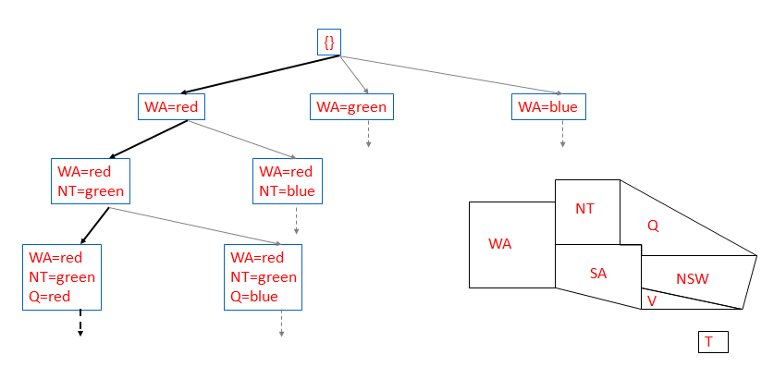
Map Coloring
7.1 Constraint satisfaction problem
7.1.1 Example Map Coloring
7.2 Solving Constraint satisfaction problem
7.2.1 Backtracking
7.2.2 Forward Checking
7.2.3 Ordering
7.3 Queens Problem
7.4 Cryptoarithmetic Problem

Slide 24
Map Coloring
{}
WA=red
WA=green
WA=blue
WA=red
NT=green
WA=red
NT=blue
NT
Q
WA
WA=red
NT=green
Q=red
WA=red
NT=green
Q=blue
SA
NSW
V
T

Slide 25
Questions
7.1 Constraint satisfaction problem
7.1.1 Example Map Coloring
7.2 Solving Constraint satisfaction problem
7.2.1 Backtracking
7.2.2 Forward Checking
7.2.3 Ordering
7.3 Queens Problem
7.4 Cryptoarithmetic Problem
Which variable X should be assigned a value next?
In which order should its domain D be sorted?

Slide 26
Questions
7.1 Constraint satisfaction problem
7.1.1 Example Map Coloring
7.2 Solving Constraint satisfaction problem
7.2.1 Backtracking
7.2.2 Forward Checking
7.2.3 Ordering
7.3 Queens Problem
7.4 Cryptoarithmetic Problem
Which variable X should be assigned a value next?
In which order should its domain D be sorted?
What are the implications of a partial assignment for yet unassigned variables? (→ Constraint Propagation)

Slide 27
Choice of Variable
7.1 Constraint satisfaction problem
7.1.1 Example Map Coloring
7.2 Solving Constraint satisfaction problem
7.2.1 Backtracking
7.2.2 Forward Checking
7.2.3 Ordering
7.3 Queens Problem
7.4 Cryptoarithmetic Problem
Map coloring
NT
NT
Q
WA
WA
SA
SA
NSW
V
T

Slide 28
Choice of Variable
7.1 Constraint satisfaction problem
7.1.1 Example Map Coloring
7.2 Solving Constraint satisfaction problem
7.2.1 Backtracking
7.2.2 Forward Checking
7.2.3 Ordering
7.3 Queens Problem
7.4 Cryptoarithmetic Problem
#1: Minimum Remaining Values (aka Most-constrained-variable heuristic):
Select a variable with the fewest remaining values

Slide 29
Choice of Variable
7.1 Constraint satisfaction problem
7.1.1 Example Map Coloring
7.2 Solving Constraint satisfaction problem
7.2.1 Backtracking
7.2.2 Forward Checking
7.2.3 Ordering
7.3 Queens Problem
7.4 Cryptoarithmetic Problem
NT
Q
WA
SA
SA
#2: Degree Heuristic (aka Most-constraining-variable heuristic):
Select the variable that is involved in the largest number of constraints on other unassigned variables
NSW
V
T

Slide 30
Choice of Value
7.1 Constraint satisfaction problem
7.1.1 Example Map Coloring
7.2 Solving Constraint satisfaction problem
7.2.1 Backtracking
7.2.2 Forward Checking
7.2.3 Ordering
7.3 Queens Problem
7.4 Cryptoarithmetic Problem
NT
NT
Q
WA
WA
SA
NSW
V
{}
T

Slide 31
Choice of Value
7.1 Constraint satisfaction problem
7.1.1 Example Map Coloring
7.2 Solving Constraint satisfaction problem
7.2.1 Backtracking
7.2.2 Forward Checking
7.2.3 Ordering
7.3 Queens Problem
7.4 Cryptoarithmetic Problem
NT
NT
Q
WA
WA
SA
NSW
V
{blue}
T
#3: Least-constraining-value heuristic:
Prefer the value that leaves the largest subset of legal values for other unassigned variables

Slide 32
Map Coloring
NT
Q
WA
NSW
T
SA
V
WA | NT | Q | NSW | V | SA | T
RGB | RGB | RGB | RGB | RGB | RGB | RGB

Slide 33
Map Coloring
NT
Q
WA
NSW
T
SA
V
WA | NT | Q | NSW | V | SA | T
RGB | RGB | RGB | RGB | RGB | RGB | RGB
R | GB | RGB | RGB | RGB | GB | RGB

Slide 34
Map Coloring
NT
Q
WA
NSW
T
SA
V
WA | NT | Q | NSW | V | SA | T
RGB | RGB | RGB | RGB | RGB | RGB | RGB
R | GB | RGB | RGB | RGB | GB | RGB
R | B | G | RB | RGB | B | RGB

Slide 35
Map Coloring
NT
Q
WA
NSW
T
SA
V
Impossible assignments that forward
checking do not detect
WA | NT | Q | NSW | V | SA | T
RGB | RGB | RGB | RGB | RGB | RGB | RGB
R | GB | RGB | RGB | RGB | GB | RGB
R | B | G | RB | RGB | B | RGB
R | B | G | R | B |  | RGB

Slide 36
Solving constraint satisfaction problem
7.1 Constraint satisfaction problem
7.1.1 Example Map Coloring
7.2 Solving Constraint satisfaction problem
7.2.1 Backtracking
7.2.2 Forward Checking
7.2.3 Ordering
7.3 Queens Problem
7.4 Cryptoarithmetic Problem
1. Backtracking
Backtracking search is an optimisation on depth-first search utilised specifically for the problem of constraint satisfaction, with the improvements deriving from the following two main principles:
An ordering for variables is fixed and values for variables are selected in this order. Because assignments are commutative (for example, assigning WA = Red, NT = Green is identical to NT = Green, WA = Red ) which is valid.
When the values for a variable is selected, the values are only selected which do not conflict with any previously as signed values. If no such values exist, backtrack and return to the previous variable, changing its value

Slide 37
→ Backtracking Search
empty assignment
1st variable
2nd variable
3rd variable
Assignment = {}

Slide 38
→ Backtracking Search
empty assignment
1st variable
2nd variable
3rd variable
Assignment = {(var1=v11)}

Slide 39
→ Backtracking Search
empty assignment
1st variable
2nd variable
3rd variable
Assignment = {(var1=v11),(var2=v21)}

Slide 40
→ Backtracking Search
empty assignment
1st variable
2nd variable
3rd variable
Assignment = {(var1=v11),(var2=v21),(var3=v31)}

Slide 41
→ Backtracking Search
empty assignment
1st variable
2nd variable
3rd variable
Assignment = {(var1=v11),(var2=v21),(var3=v32)}

Slide 42
→ Backtracking Search
empty assignment
1st variable
2nd variable
3rd variable
Assignment = {(var1=v11),(var2=v22)}

Slide 43
→ Backtracking Search
empty assignment
1st variable
2nd variable
3rd variable
Assignment = {(var1=v11),(var2=v22),(var3=v31)}

Slide 44
Backtracking search
7.1 Constraint satisfaction problem
7.1.1 Example Map Coloring
7.2 Solving Constraint satisfaction problem
7.2.1 Backtracking
7.2.2 Forward Checking
7.2.3 Ordering
7.3 Queens Problem
7.4 Cryptoarithmetic Problem
Variable assignments are commutative}, i.e.,
[ WA = red then NT = green ] same as [ NT = green then WA = red ]
Only need to consider assignments to a single variable at each node
→ b = d and there are d^{n} leaves
Depth-first search for CSPs with single-variable assignments is called backtracking search
Backtracking search is the basic uninformed algorithm for CSPs
Can solve n-queens for n ≈ 25

Slide 45

Backtracking example
7.1 Constraint satisfaction problem
7.1.1 Example Map Coloring
7.2 Solving Constraint satisfaction problem
7.2.1 Backtracking
7.2.2 Forward Checking
7.2.3 Ordering
7.3 Queens Problem
7.4 Cryptoarithmetic Problem

Slide 46
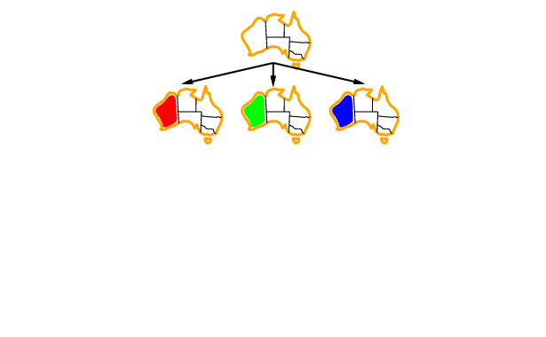
Backtracking example
7.1 Constraint satisfaction problem
7.1.1 Example Map Coloring
7.2 Solving Constraint satisfaction problem
7.2.1 Backtracking
7.2.2 Forward Checking
7.2.3 Ordering
7.3 Queens Problem
7.4 Cryptoarithmetic Problem

Slide 47
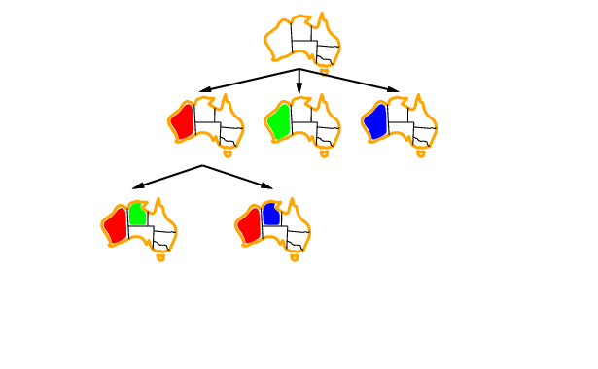
Backtracking example
7.1 Constraint satisfaction problem
7.1.1 Example Map Coloring
7.2 Solving Constraint satisfaction problem
7.2.1 Backtracking
7.2.2 Forward Checking
7.2.3 Ordering
7.3 Queens Problem
7.4 Cryptoarithmetic Problem

Slide 48
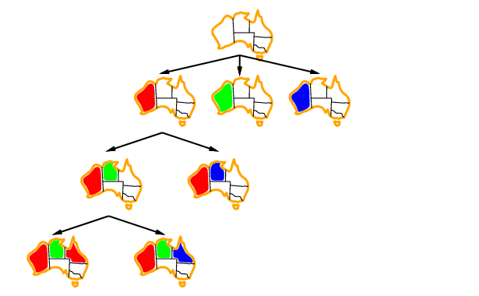
Backtracking example
7.1 Constraint satisfaction problem
7.1.1 Example Map Coloring
7.2 Solving Constraint satisfaction problem
7.2.1 Backtracking
7.2.2 Forward Checking
7.2.3 Ordering
7.3 Queens Problem
7.4 Cryptoarithmetic Problem

Slide 49

Most constrained variable
7.1 Constraint satisfaction problem
7.1.1 Example Map Coloring
7.2 Solving Constraint satisfaction problem
7.2.1 Backtracking
7.2.2 Forward Checking
7.2.3 Ordering
7.3 Queens Problem
7.4 Cryptoarithmetic Problem
Most constrained variable:
choose the variable with the fewest legal values
a.k.a. minimum remaining values (MRV) heuristic

Slide 50

Most constraining variable
7.1 Constraint satisfaction problem
7.1.1 Example Map Coloring
7.2 Solving Constraint satisfaction problem
7.2.1 Backtracking
7.2.2 Forward Checking
7.2.3 Ordering
7.3 Queens Problem
7.4 Cryptoarithmetic Problem
Tie-breaker among most constrained variables
Most constraining variable:
choose the variable with the most constraints on remaining variables

Slide 51
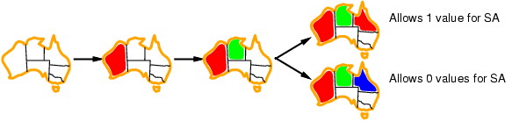
Least constraining value
7.1 Constraint satisfaction problem
7.1.1 Example Map Coloring
7.2 Solving Constraint satisfaction problem
7.2.1 Backtracking
7.2.2 Forward Checking
7.2.3 Ordering
7.3 Queens Problem
7.4 Cryptoarithmetic Problem
Given a variable, choose the least constraining value:
the one that rules out the fewest values in the remaining variables

Slide 52
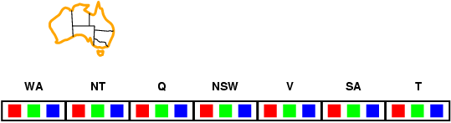
Forward checking
7.1 Constraint satisfaction problem
7.1.1 Example Map Coloring
7.2 Solving Constraint satisfaction problem
7.2.1 Backtracking
7.2.2 Forward Checking
7.2.3 Ordering
7.3 Queens Problem
7.4 Cryptoarithmetic Problem
Idea:
Keep track of remaining legal values for unassigned variables
Terminate search when any variable has no legal values

Slide 53
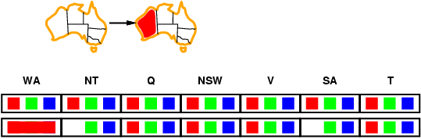
Forward checking
7.1 Constraint satisfaction problem
7.1.1 Example Map Coloring
7.2 Solving Constraint satisfaction problem
7.2.1 Backtracking
7.2.2 Forward Checking
7.2.3 Ordering
7.3 Queens Problem
7.4 Cryptoarithmetic Problem
Idea:
Keep track of remaining legal values for unassigned variables
Terminate search when any variable has no legal values

Slide 54
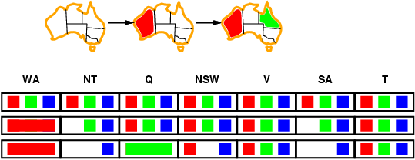
Forward checking
7.1 Constraint satisfaction problem
7.1.1 Example Map Coloring
7.2 Solving Constraint satisfaction problem
7.2.1 Backtracking
7.2.2 Forward Checking
7.2.3 Ordering
7.3 Queens Problem
7.4 Cryptoarithmetic Problem
Idea:
Keep track of remaining legal values for unassigned variables
Terminate search when any variable has no legal values.

Slide 55
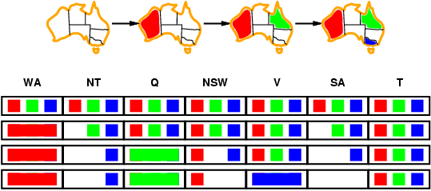
Forward checking
7.1 Constraint satisfaction problem
7.1.1 Example Map Coloring
7.2 Solving Constraint satisfaction problem
7.2.1 Backtracking
7.2.2 Forward Checking
7.2.3 Ordering
7.3 Queens Problem
7.4 Cryptoarithmetic Problem
Idea:
Keep track of remaining legal values for unassigned variables
Terminate search when any variable has no legal values.

Slide 56
Solving constraint satisfaction problem
7.1 Constraint satisfaction problem
7.1.1 Example Map Coloring
7.2 Solving Constraint satisfaction problem
7.2.1 Backtracking
7.2.2 Forward Checking
7.2.3 Ordering
7.3 Queens Problem
7.4 Cryptoarithmetic Problem
3. Ordering
Minimum remaining values (MRV): While selecting the variable to assign next, using an MRV policy chooses whichever unassigned variable has the fewest valid remaining values (the most constrained variable). This is intuitive in the sense that the most constrained variable is most likely to run out of possible values and resulting in backtracking if it is left unassigned, and so it is best to assign a value to it sooner than later.
Least constraining value (LCV): Similarly, while selecting which value to assign next, a good policy to implement is to select the value that prunes the fewest values from the domains of the remaining unassigned values. Notably, additional computation is required for this (for example, rerunning arc consistency/forward checking or other filtering methods for each value to find the LCV), but can still yield speed gains depending on the usage.

Slide 57

4-Queens Problem
7.1 Constraint satisfaction problem
7.1.1 Example Map Coloring
7.2 Solving Constraint satisfaction problem
7.2.1 Backtracking
7.2.2 Forward Checking
7.2.3 Ordering
7.3 Queens Problem
7.4 Cryptoarithmetic Problem

Slide 58
4-Queens Problem
X1
{1,2,3,4}
X2
{1,2,3,4}
1
2
3
4
1
2
3
4
X3
{1,2,3,4}
X4
{1,2,3,4}

Slide 59
4-Queens Problem
X1
{1,2,3,4}
X2
{1,2,3,4}
1
2
3
4
1
2
3
4
X3
{1,2,3,4}
X4
{1,2,3,4}

Slide 60
4-Queens Problem
X1
{1,2,3,4}
X2
{1,2,3,4}
1
2
3
4
1
2
3
4
X3
{1,2,3,4}
X4
{1,2,3,4}

Slide 61
4-Queens Problem
X1
{1,2,3,4}
X2
{1,2,3,4}
1
2
3
4
1
2
3
4
X3
{1,2,3,4}
X4
{1,2,3,4}

Slide 62
4-Queens Problem
X1
{1,2,3,4}
X2
{1,2,3,4}
1
2
3
4
1
2
3
4
X3
{1,2,3,4}
X4
{1,2,3,4}

Slide 63
4-Queens Problem
X1
{1,2,3,4}
X2
{1,2,3,4}
1
2
3
4
1
2
3
4
X3
{1,2,3,4}
X4
{1,2,3,4}

Slide 64
4-Queens Problem
X1
{1,2,3,4}
X2
{1,2,3,4}
1
2
3
4
1
2
3
4
X3
{1,2,3,4}
X4
{1,2,3,4}

Slide 65
4-Queens Problem
X1
{1,2,3,4}
X2
{1,2,3,4}
1
2
3
4
1
2
3
4
X3
{1,2,3,4}
X4
{1,2,3,4}

Slide 66
4-Queens Problem
X1
{1,2,3,4}
X2
{1,2,3,4}
1
2
3
4
1
2
3
4
X3
{1,2,3,4}
X4
{1,2,3,4}

Slide 67
4-Queens Problem
X1
{1,2,3,4}
X2
{1,2,3,4}
1
2
3
4
1
2
3
4
X3
{1,2,3,4}
X4
{1,2,3,4}

Slide 68
Cryptoarithmetic Problem
7.1 Constraint satisfaction problem
7.1.1 Example Map Coloring
7.2 Solving Constraint satisfaction problem
7.2.1 Backtracking
7.2.2 Forward Checking
7.2.3 Ordering
7.3 Queens Problem
7.4 Cryptoarithmetic Problem
Cryptarithmetic problems are where numbers are replaced with the alphabets. By using standard arithmetic rules we need to decipher the alphabet.
General rules:
Each alphabet takes only one number from 0 to 9 uniquely.
Sum of two single digit numbers can be maximum 19 with the carryover. So, carry over in problems of two number addition is always 1.
Try to solve the leftmost digit in the given problem.
If a * b = kb, the following are the possibilities:
(3 * 5 = 15; 7 * 5 = 35; 9 * 5 = 45) or (2 * 6 = 12; 4 * 6 = 24; 8 * 6 = 48)

Slide 69
7.1 Constraint satisfaction problem
7.1.1 Example Map Coloring
7.2 Solving Constraint satisfaction problem
7.2.1 Backtracking
7.2.2 Forward Checking
7.2.3 Ordering
7.3 Queens Problem
7.4 Cryptoarithmetic Problem
Constraints in Cryptarithmetic Problems
1. no two digit can be assigned to same letter.
2. only single digit number can be assign to a letter.
1. no two letters can be assigned same digit.
2. Assumption can be made at various levels such that they do not contradict each other.
3. The problem can be decomposed into secured constraints. A constraint satisfaction approach may be used.
4. Any of search techniques may be used.
5. Backtracking may be performed as applicable us applied search techniques.
6. Rule of arithmetic may be followed.

Slide 70
Problem Statement
7.1 Constraint satisfaction problem
7.1.1 Example Map Coloring
7.2 Solving Constraint satisfaction problem
7.2.1 Backtracking
7.2.2 Forward Checking
7.2.3 Ordering
7.3 Queens Problem
7.4 Cryptoarithmetic Problem
How to assign decimal digits to letters, so that the following sum is valid? Assume that we already
know that
The possible digits set for the letters is {0,1,2,…9};
M must be 1;
Two different letters can't be assigned the same digit
SEND
+ MORE
--------
MONEY

Slide 71
using c1,c2 and c3 to represent carries changing problem to solve 4 equations
7.1 Constraint satisfaction problem
7.1.1 Example Map Coloring
7.2 Solving Constraint satisfaction problem
7.2.1 Backtracking
7.2.2 Forward Checking
7.2.3 Ordering
7.3 Queens Problem
7.4 Cryptoarithmetic Problem
S E N D D+E = Y+10*C1
M O R E C1+N+R = E+10*C2
+ C3 C2 C1 C2+E+O = N+10*C3
---------------------- C3+S+M = O+10*M
M O N E Y

Slide 72

Dr. Nilakshi Jain Email ID : nilakshijain1986@gmail.com
Thank you

